Slide 1


PROJECT
HAND WRITTEN
RECOGNITION

Slide 2

GROUP
1
V.SUJAY
5
VK SANTOSH
2
B.SRI KOWSHIKA RAJ
3
Y MANOJ
4
M SURESH

Slide 3

AIM:
To understand traditional machine learning techniques comprehensively. This entails learning and applying these techniques to address a chosen task, conducting systematic performance evaluations, comparing different methods, and developing innovative ideas.

Slide 4

ALGORITHMS USED:
Knn Classifier
Neural Network
Convolutional Neural Network (CNN)
Random Forest Classifier
Decision Tree Classifier
Classifier Using Multi-Layer Perceptrons (MLP)
svm

Slide 5
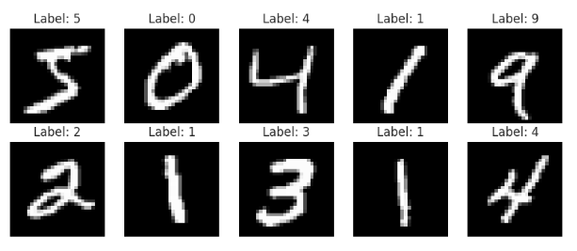

Exploring MNIST Dataset for Digit Recognition
Dataset overview:
70,000 grayscale images of handwritten
digits (0-9) at 28x28 pixels.
Loaded using mnist.load_data(),
providing training and testing sets.

Slide 6
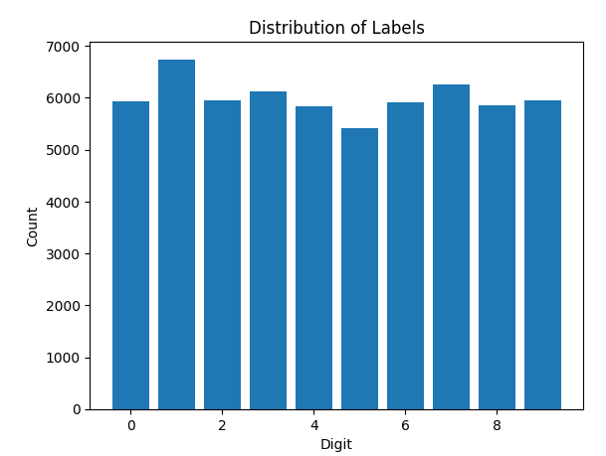
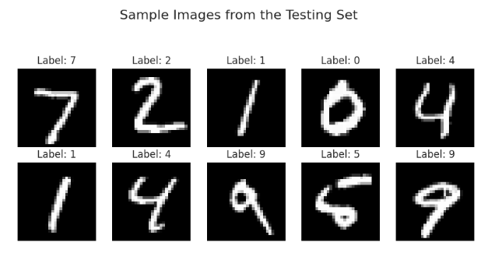
Visualization:
Displayed sample images from training set with labels.
Bar plot indicating distribution of digit labels, highlighting class balance.
Data Preprocessing:
Reshaped images to (28x28x1) single channel.
Normalized pixel values to [0, 1] range.
Split training data into sets using train_test_split()

Slide 7
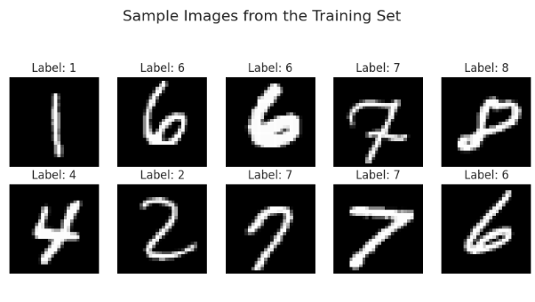
Additional Visualization:
Showcased sample photos and preprocessed images.
Dataset Details:
60,000 samples in training set, 10,000 in testing set.
Image shape: (28, 28, 1).
Total unique classes: 10.

Slide 8
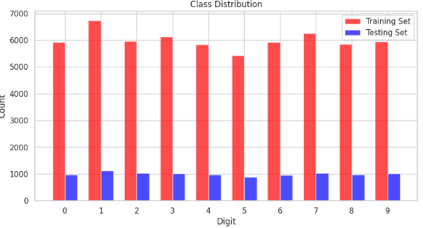
Class Distribution Plot:
Compared digit distribution in training and
testing sets.
Conclusion:
Prepared MNIST dataset for ML model training,
aiding digit recognition tasks.

Slide 9
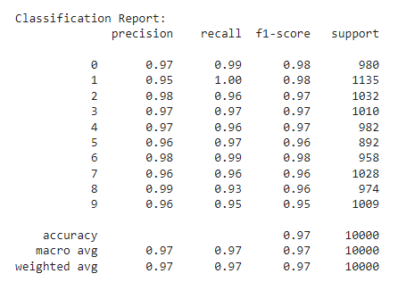
KNN CLASSIFIER:
Title: Enhancing MNIST Digit Recognition with KNN
OBJECTIVE:
MNIST digit classification using KNN algorithm.
APPROACH:
Data reshaped to 1D arrays for KNN compatibility.
KNN model trained with 5 neighbors.
RESULT:
Achieved 96% accuracy.
Detailed classification report and confusion matrix analysis provided
INSIGHT:
KNN's efficacy in handling pixel-based features.
Considerations: visual similarity impact and class imbalance.

Slide 10
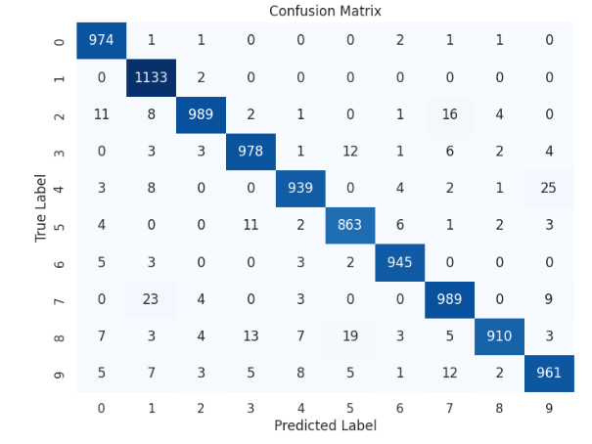
RESULT:
Achieved 96% accuracy.
Detailed classification report and confusion matrix analysis provided
INSIGHT:
KNN's efficacy in handling pixel-based features.
Considerations: visual similarity impact and class imbalance.

Slide 11
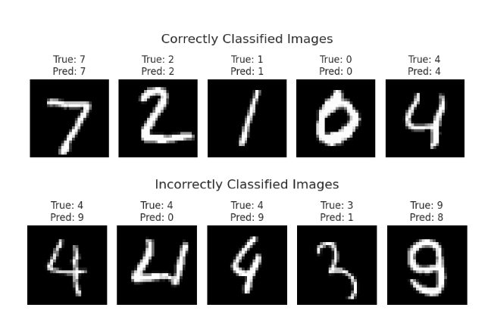
CONCLUSION:
KNN offers robust performance but warrants hyperparameter optimization
Real-world applications necessitate balancing recall and precision
VISUALS:
Accuracy metrics, classification report, and confusion matrix illustration.

Slide 12
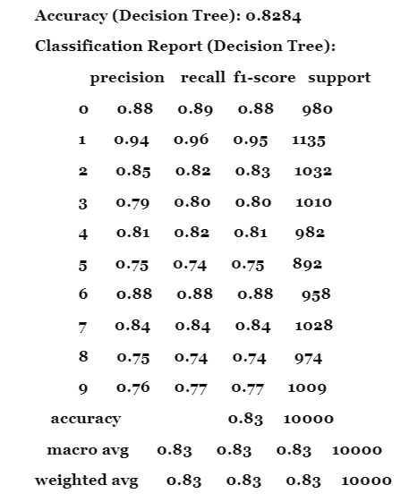
Comparing Random Forest and Decision Tree Classifiers for MNIST Digit Recognition
Summary:
Random Forest Classifier:
Default hyperparameters set.
Trained on preprocessed data with 95% accuracy.
Detailed classification report and confusion matrix provided.
Decision Tree Classifier:
Gini impurity criteria used by default.
Achieved 83% accuracy.
Comparable evaluation metrics to Random Forest.
Comparison:
Performance:
Random Forest outperforms Decision Tree due to ensemble approach.
Random Forest exhibits higher accuracy and generalization capacity.
Interpretability:
Decision Trees are more interpretable than Random Forest.
Random Forest's ensemble method reduces interpretability.

Slide 13
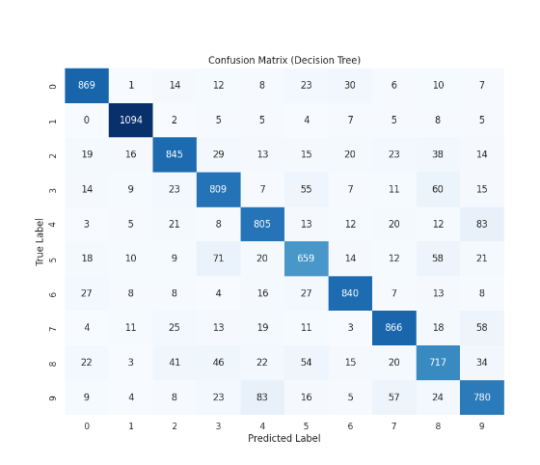
Scalability:
Decision Trees faster for smaller datasets.
Random Forest handles larger datasets effectively.
Tuning Complexity:
Random Forest requires more hyperparameter
tuning due to ensemble learning.
Conclusion:
Both classifiers offer distinct advantages.
Decision Trees are simpler but less accurate.
Random Forest provides higher accuracy and
scalability but requires more tuning.
Visuals:
Accuracy scores, classification reports, and
confusion matrices for both classifiers.

Slide 14
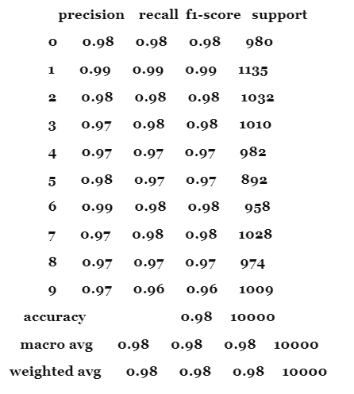
MLP for Handwritten Digit Recognition
Summary:
Initialization: Initialized MLP classifier with hyperparameters.
Training: Fit method trained MLP classifier on preprocessed data.
Prediction: Predicted test set labels using trained MLP classifier.
Performance Evaluation: Assessed accuracy,
generated classification report, and calculated confusion matrix.
Performance Metrics:
Accuracy: Achieved 97.73% accuracy.
Classification Report: Provided precision, recall, F1-score, and
support for each class.
Confusion Matrix: Visualized classifier's performance across classes.

Slide 15
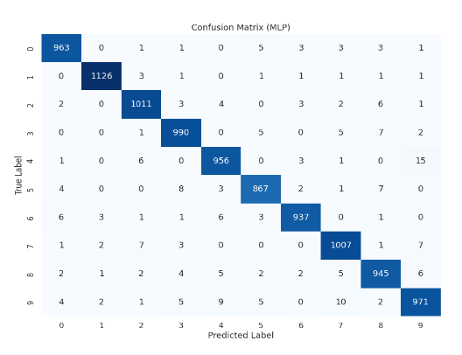
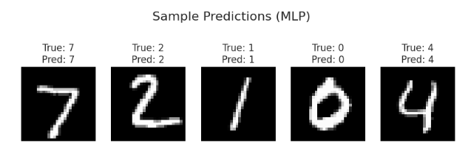
Our Approach:
Configured MLP classifier with one hidden layer (100 neurons) using
ReLU activation and Adam optimizer.
Tuned hyperparameters for improved accuracy and generalization.
Visuals:
Confusion matrix and sample photos from testing set shown.

Slide 16
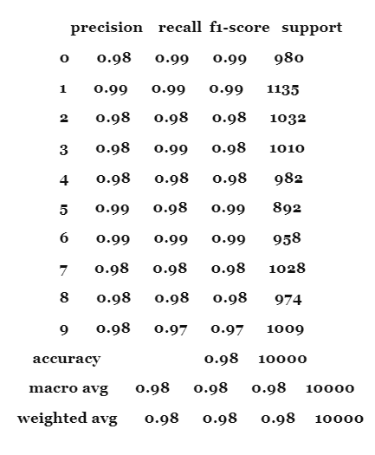
SVM for Handwritten Digit Recognition
Approach:
Data Preprocessing: MNIST dataset loaded, reshaped, and normalized.
Dimensionality Reduction: PCA applied to maintain 95% variance.
Model Training: SVM classifier trained with RBF kernel and C=1.0.
Prediction: Trained SVM used to predict test set labels.
Performance Evaluation: Accuracy (98.32%) and classification report generated.

Slide 17
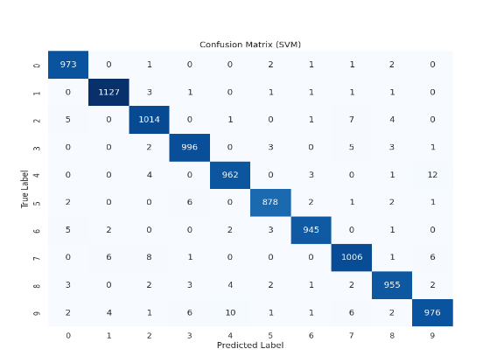
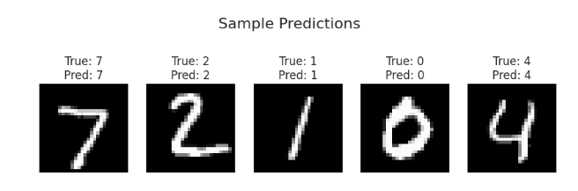
Visualisation:
Confusion matrix plotted using Seaborn's heatmap.
Grid showing sample photos from testing set with true and predicted labels.
Explanation:
SVM excels in classification, particularly with complex decision boundaries.
PCA balances information preservation and computational efficiency.
Tuning regularization parameter (C) and kernel choice optimize SVM performance.

Slide 18
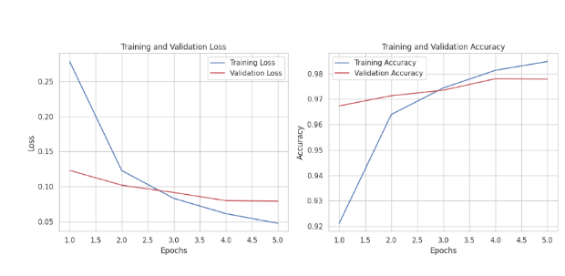

Neural Network for Digit Classification
Task Overview:
Data Preparation: MNIST dataset loaded and pixel values scaled.
Model Design: Simple architecture with one hidden layer.
Training: Utilized early stopping to prevent overfitting.
Evaluation: Achieved ~98% accuracy on test set.
Observations:
High Accuracy: Demonstrated effective digit classification.
Generalisation: Model performed well unseen data.
Conclusion:
Successfully trained neural network for digit categorization.
Further optimization possible for increased accuracy.
Consider trade-offs between complexity and generalization.

Slide 19
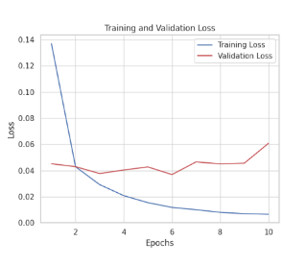
CNN for Digit Classification
Explanation:
Objective: Developed CNN to classify MNIST handwritten digits.
Data Prep: Reshaped images, scaled pixel values.
Model: CNN with convolutional, pooling, dense layers.
Compilation: Used Adam optimizer, sparse categorical cross-entropy loss.
Training: Trained on 75% training data, applied early stopping.
Evaluation: Achieved ~99% accuracy on test set.
Observations:
High Accuracy: ~99% accuracy achieved.
Feature Extraction: Convolutional layers extract relevant information.
Reasoning:
Hierarchical Features: Layers capture low-level to complex patterns.
-Regularization: Dropout or batch normalization could improve generalization.
Conclusion:
CNNs excel in image categorization.
Further optimization possible through hyperparameter adjustments.
Understanding CNN architectures crucial for effective image recognition.

Slide 20
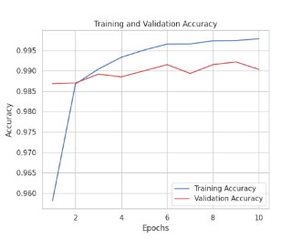
Reasoning:
Hierarchical Features: Layers capture low-level to complex patterns.
Regularization: Dropout or batch normalization could improve generalization.
Conclusion:
CNNs excel in image categorization.
Further optimization possible through hyperparameter adjustments.
Understanding CNN architectures crucial for effective image recognition.

Slide 21
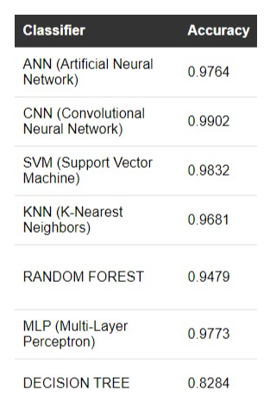
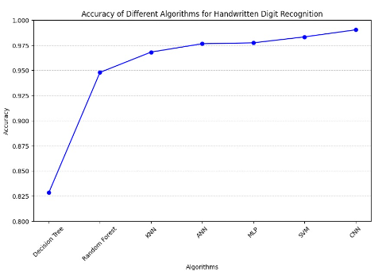
Conclusion:
Cnn has the highest accuracy so we decided to implement machine learning model using CNN and integrate it with webpage.

Slide 22
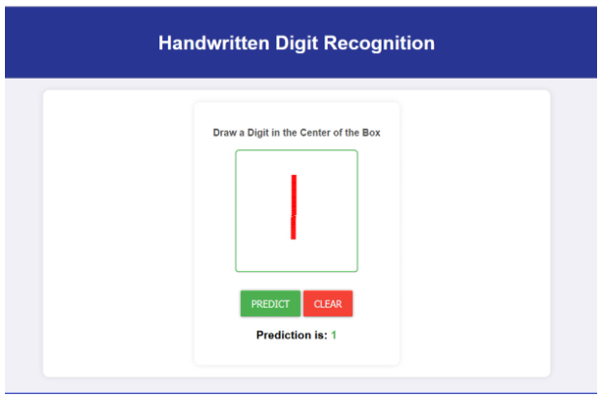
Webpage
Technologies used:
1.HTML
2.CSS
3.JavaScript :
4.Python
5.Flask
Requirements:
torch
numpy==1.16.5
flask==1.1.1
gunicorn
matplotlib==3.3.1
pillow==6.2.0
flake8
pip
pylint

Slide 23
Approach:
The integration process began with the development of a custom CNN architecture using PyTorch. The model was trained on a dataset of handwritten digits, achieving a validation accuracy of approximately 99%. To deploy the model on the web, a Flask application was created to handle incoming digit images and provide real-time predictions. The frontend interface allowed users to draw digits using an HTML canvas element, with JavaScript capturing and sending the drawn images to the Flask server.
Model Architecture:
The CNN architecture consisted of convolutional layers followed by fully connected layers, with dropout regularization to prevent overfitting. Input images were standardized to 28x28 pixels and pixel values were normalized to a range of 0 to 1. Training utilized stochastic gradient descent (SGD) as the optimizer and negative log likelihood loss (NLLLoss) as the loss function.
Challenges and Further Improvements:
Despite successful model training and integration, challenges arose during the deployment phase, particularly in deploying the web application using AWS. Unsuccessful attempts were made, prompting the project team to focus on resolving deployment issues before the scheduled viva. Future improvements include exploring alternative deployment options and optimizing the web application for scalability and performance.
Conclusion:
The development and deployment of a real-time digit recognition web application using machine learning techniques represent a significant step towards creating accessible and user-friendly digit recognition tools. Despite challenges encountered during deployment, the project team remains committed to resolving issues and ensuring the successful deployment of the application for practical use.

Slide 24
Thank
you!

